Slide 1
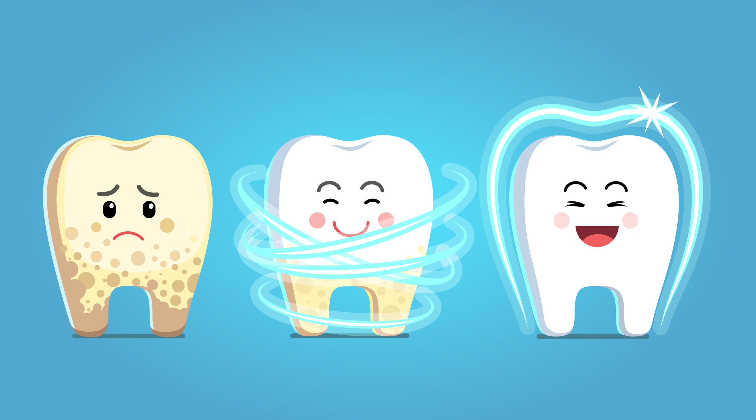
My Shiny Teeth!

Slide 2
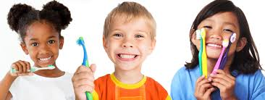
Going to the dentist, there's nothing to fear. It’s a fun adventure, so let’s give a cheer!

Slide 3
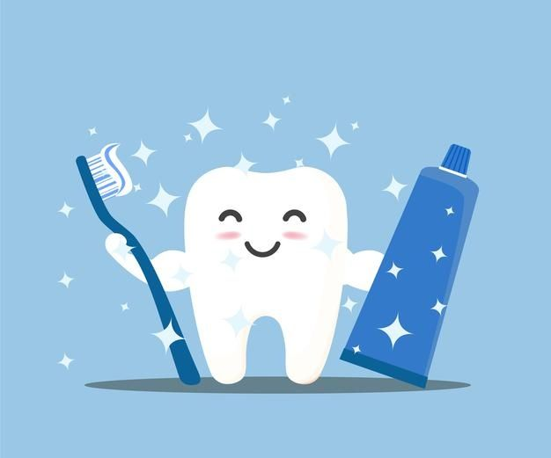
Mom or Dad is with you, right by your side. With their loving support, there's nothing to hide.

Slide 4
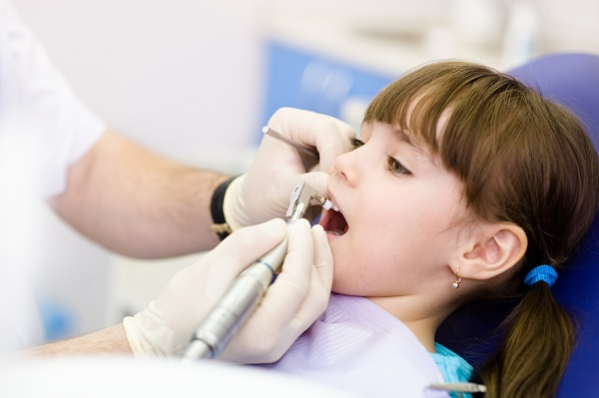
With mirrors and tools, they’ll make your teeth bright!
Your smile will sparkle, clean and white!
If you need a break, just raise your hand. The dentist will stop and understand.

Slide 5
Sit in the chair, lean back nice and slow!
With a smile on your face, your courage will show!
The dentist is kind, not scary at all.
They’ll check all your teeth, both big and small.

Slide 6
A rinse and a swish, and you’re good to go. Your teeth are all healthy, and now you know. Brush every morning and right before bed, and floss in between, like the dentist said.

Slide 7
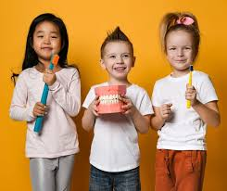
The dentist is there to take care of you. It’s an adventure, a great place to be, for healthy teeth and a smile so free!

Slide 8
The End

