Slide 1


Now Playing: Going to the Movie Theater

Slide 2
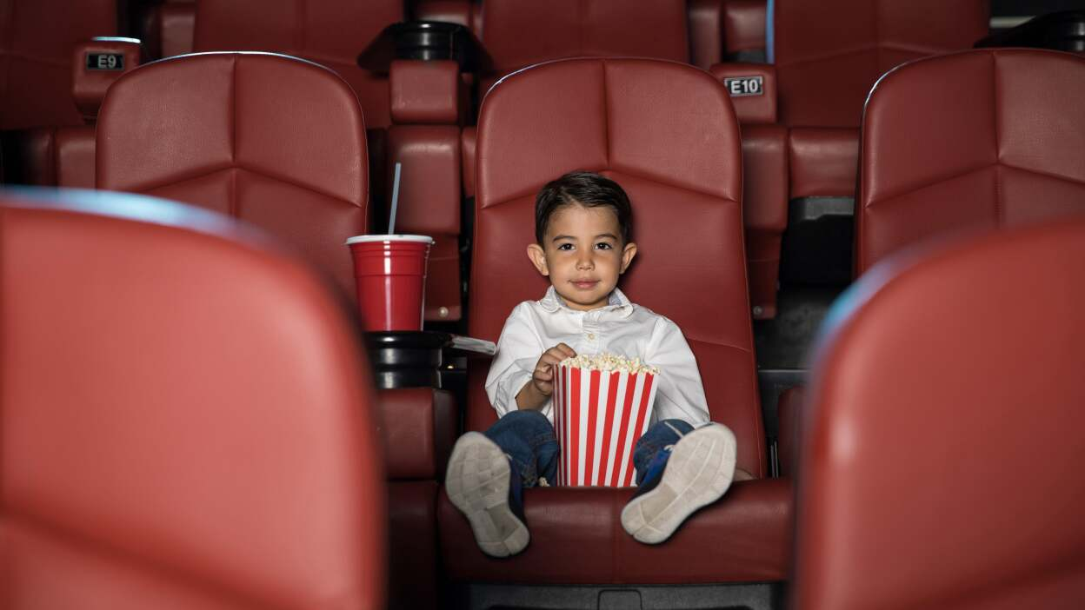
My name is Kevin. I am going to watch a movie at the movie theater.

Slide 3
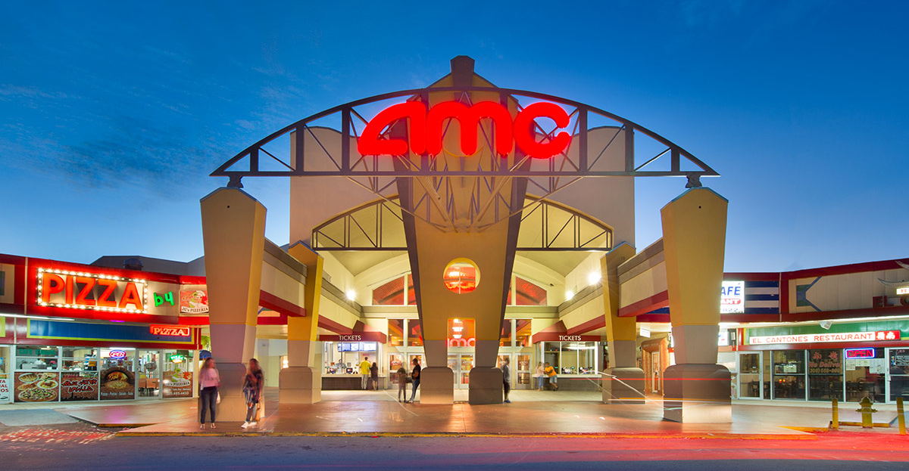
I will go to the AMC movie theater to watch a movie.

Slide 4
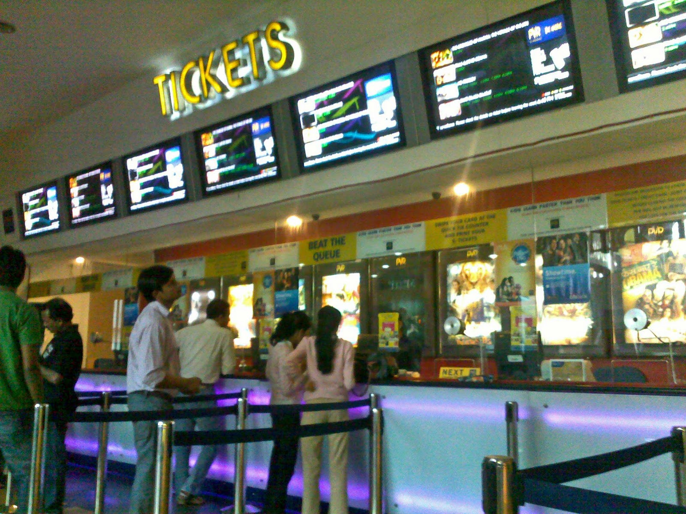
Before going in, I might need to wait in line.
Sometimes I need to wait in line to buy a movie ticket. That’s okay, I can just hold Mommy or Daddy’s hand while we wait.

Slide 5
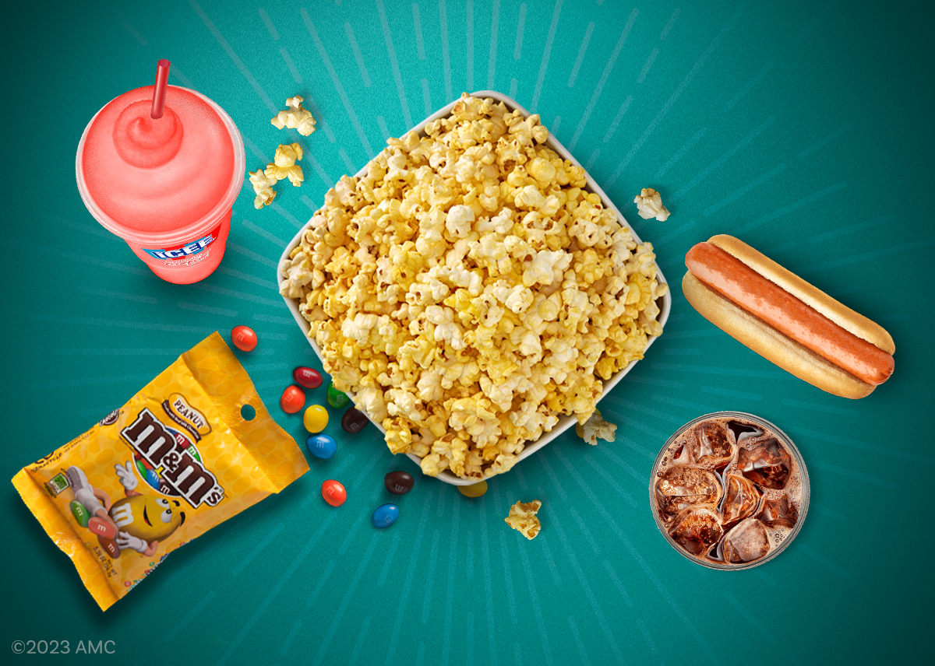
Sometimes I buy snacks at the theater. There are many options like popcorn, hot dogs, candy, and soda!
I can eat my snacks while sitting in my seat! Mom and Dad will let me know what I can get.
If I don’t like the snacks, I can always bring my own snacks from home! Yummy!

Slide 6
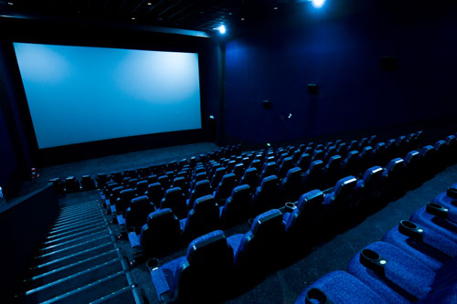
When the movie starts, the room will get dark. That’s okay, there will be bright lights from the screen!

Slide 7
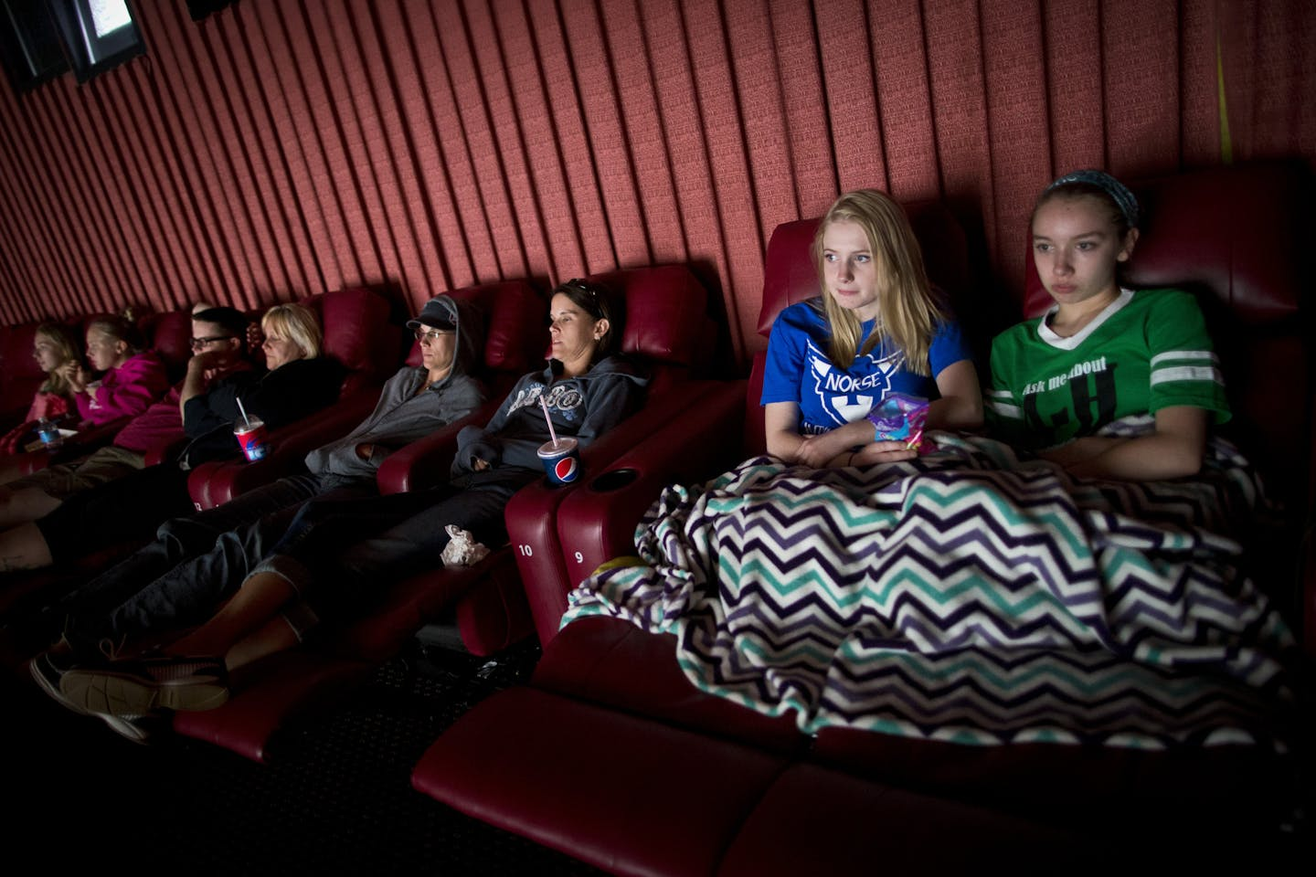
It can get cold at the theater! I can bring a sweater or a blanket to feel warm and comfortable!

Slide 8
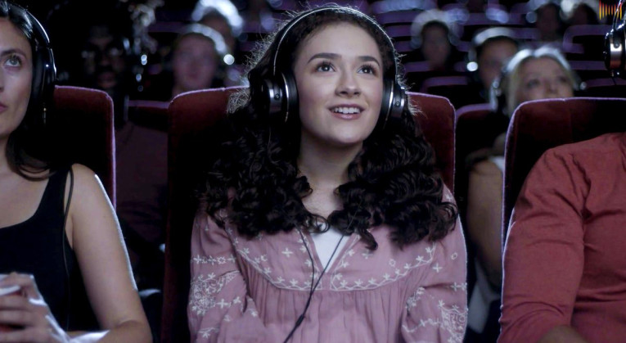
Sometimes the movie will play loud noises. It’s okay. I can cover my ears or wear headphones.

Slide 9
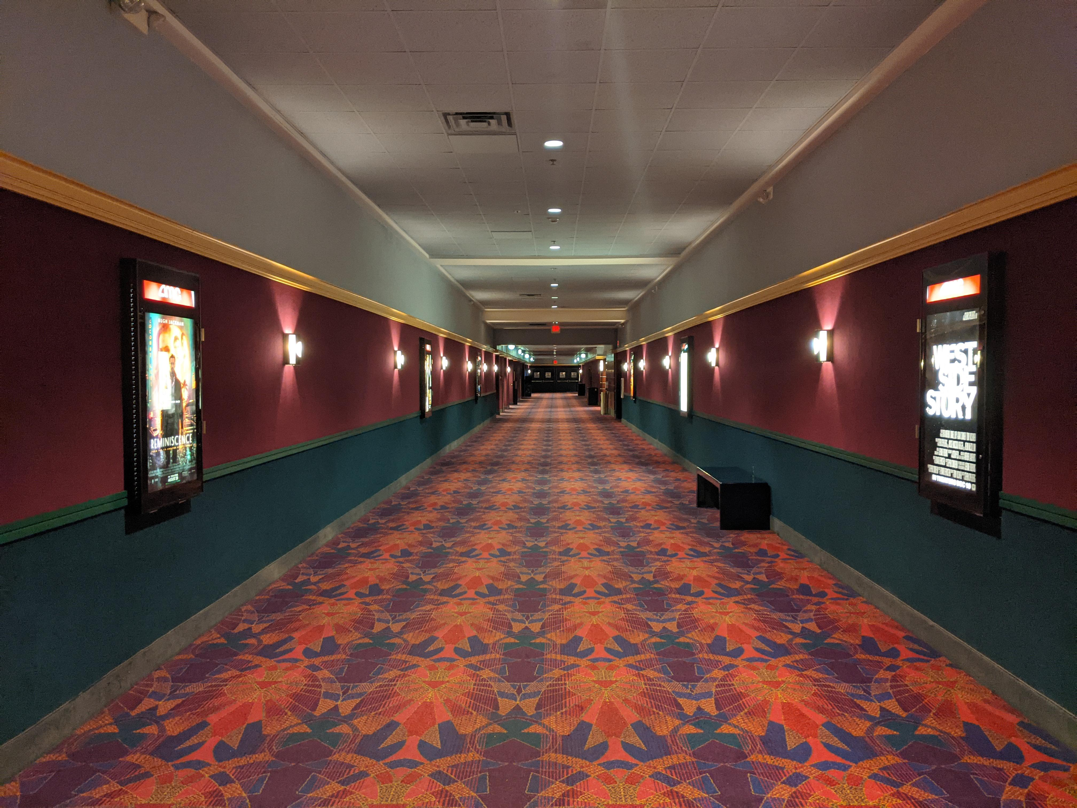
Movies can be long! If I need a break, I can tell Mommy or Daddy I want to take a break.
We can go to the bathroom, or I can have a movement break in the hallway! When I’m ready, we can go back to our seats.

Slide 10

Everyone wants to see and hear the movie. It’s important to stay quiet. I can laugh when something is funny, cry if something is sad, or close my eyes if I’m scared!

Slide 11
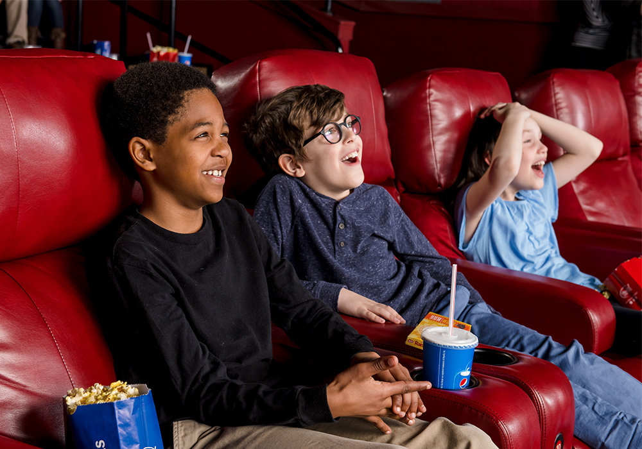
I’ll just sit back and enjoy the movie. Going to the movies is so much fun!

Slide 12

For parents: Some movie theaters play sensory friendly films!
Here is the link below:
AMC Sensory Friendly Films

