Slide 1
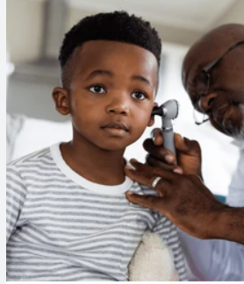
My trip to the Doctor!

Slide 2
My Mom takes me to the doctor’s office sometimes. The doctor has a nice waiting room where we wait until the doctor calls my name. It’s a place where I can play with toys and look at books. If I need a break, Mom takes me for a walk!

Slide 3
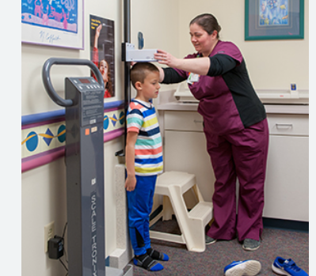
When the doctor calls my name, me and Mom go inside, and the doctor lets me know everything will be ok. He/She listens to my heart, looks in my mouth and takes my temperature. They want to see how big and strong I am!

Slide 4
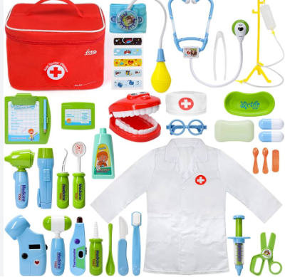
Look at these doctor tools! So cool! They use these tools during my check-up. They don’t hurt!
I even have my own doctor tools!

Slide 5
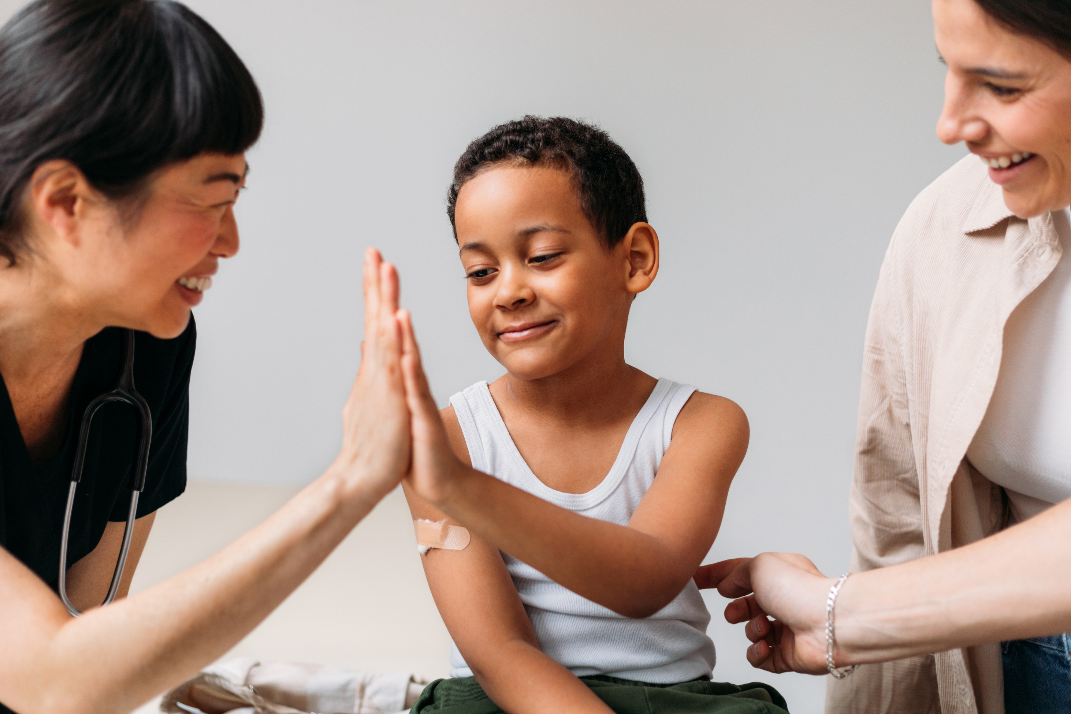
The doctor might ask us questions like, "Do you feel any pain?"
"How have you been sleeping?"
Mom will help answer questions.
I can point to where it hurts or use a picture chart to show how I feel.
The doctor understands a lot about how I might be feeling and is there to help me feel better. It's okay to show how I feel in a way that works best for me.​

Slide 6
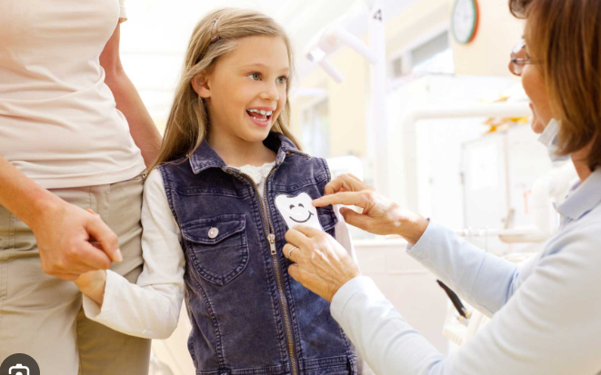
After my doctor visit, I get a special reward, like a sticker or a small toy. It makes me feel really happy and proud for being brave. I love getting my reward because it makes the visit even better!

Slide 7
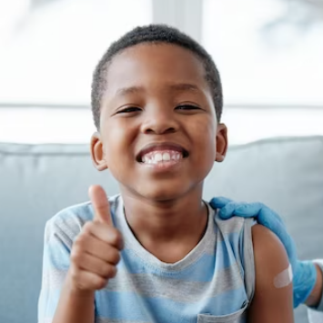
Going to the doctor keeps me healthy and helps me to grow big and strong!

