Slide 1
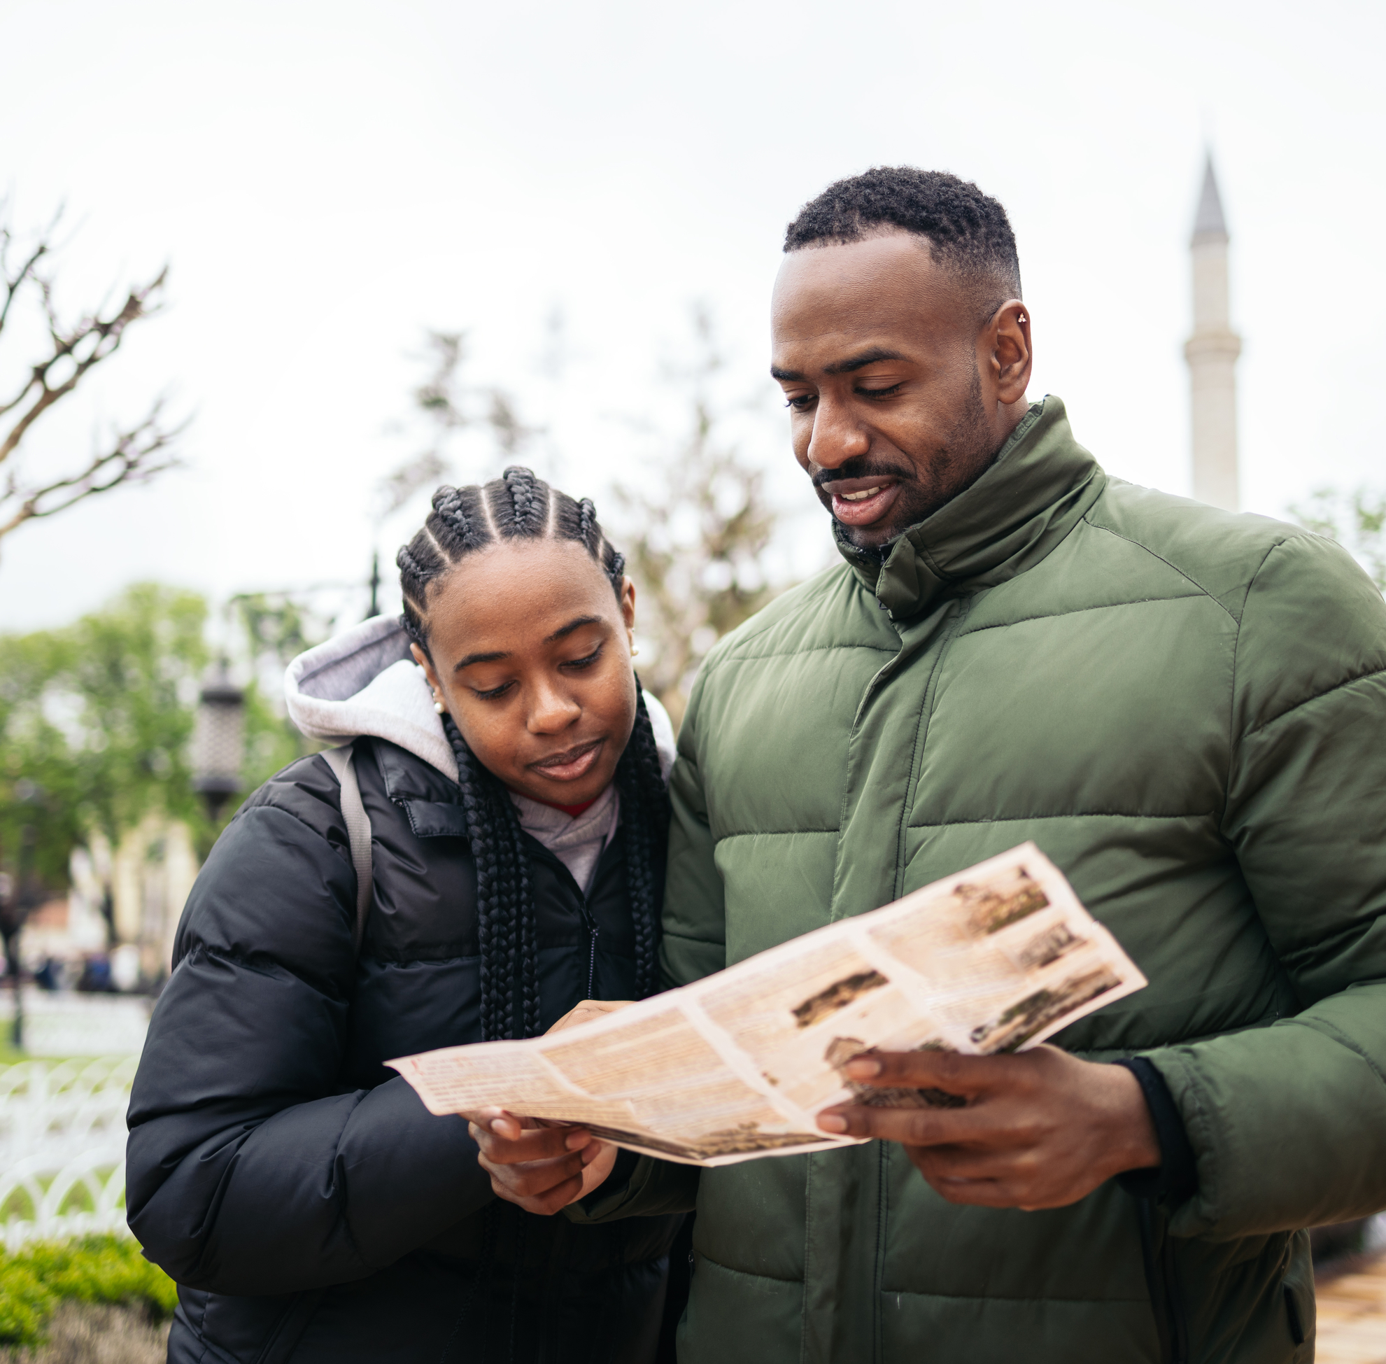
Let’s go on a trip!
I love planning a trip with Mom and Dad!

Slide 2
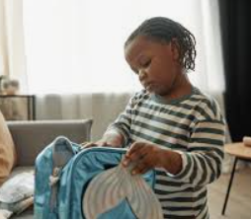
First, let's plan and pack!
First, we decide where we are going to go.
Mom tells me that this trip is to the Aquarium!
We will pack a bag with snacks, water, and my favorite toy!

Slide 3
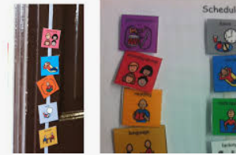
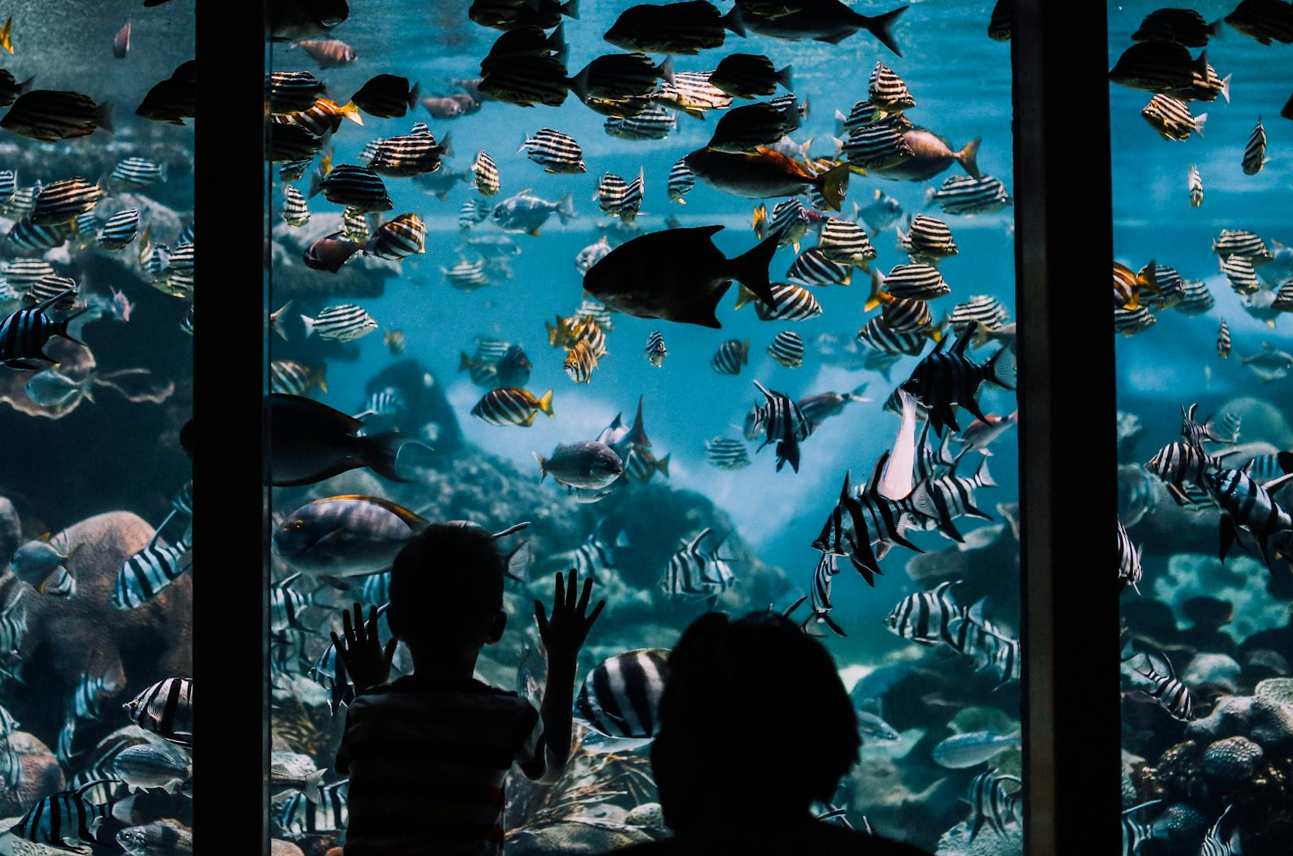
Mom and Dad make a schedule for me so that I know what we will see and do at the Aquarium! This will help me know what's going to happen on the trip!

Slide 4
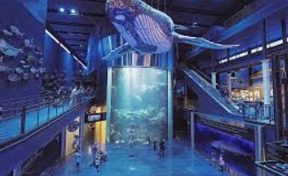
We arrive at the Aquarium! At the aquarium, I make sure to hold mom's hand! This is how I stay safe!

Slide 5
Sometimes, during a trip, it’s a little loud, and it might even start to rain! But that’s okay! I am prepared and take time to sit with Dad under the umbrella and take a few deep breaths while we watch the rain!

Slide 6
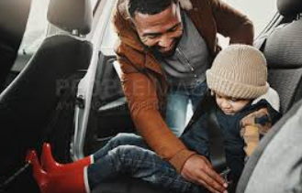
At the end of the day, it's time to go home! My mom took pictures that I can look at that will remind me of how much fun I had today!

Slide 7
Planning trips can be fun and exciting! I LOVE having new adventures with Mom and Dad!

